Slide 1
Digital Circuits Neil E Cotter ECE Dept. University of Utah

Slide 2
Digital Electronics
NAND

Slide 3
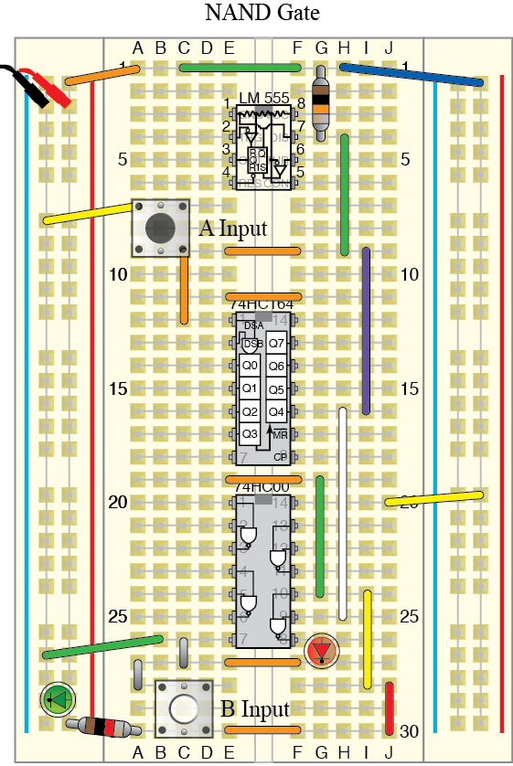
Digital Electronics: NAND Gate

Slide 4
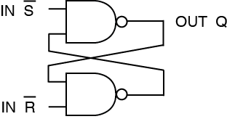
Digital Electronics
Flip-Flop

Slide 5
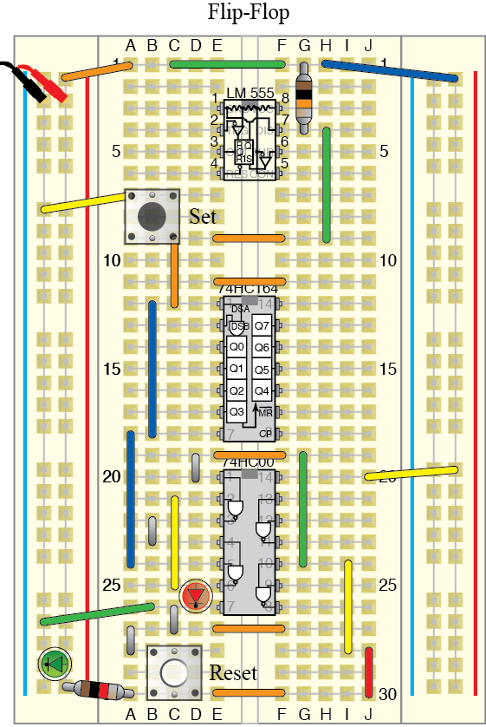
Digital Electronics: Flip Flop

