Slide 1
Pulsed Neural Networks
Neil E. Cotter
ECE Department
University of Utah
Notes:
Type notes here

Slide 2

Overview
Notes:
Type notes here

Slide 3
Challenging Problems
Notes:
Type notes here

Slide 4
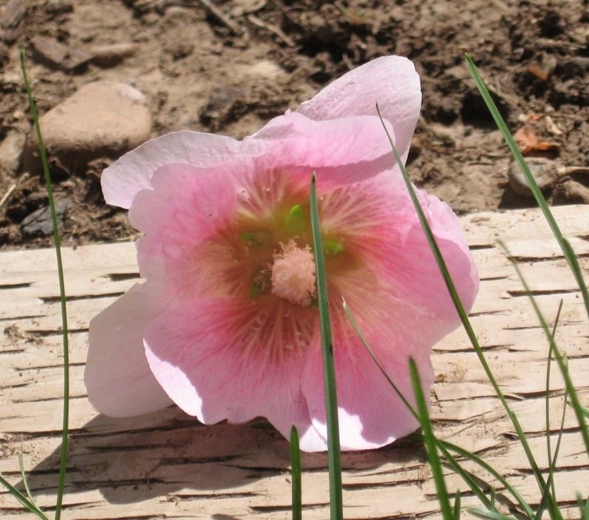
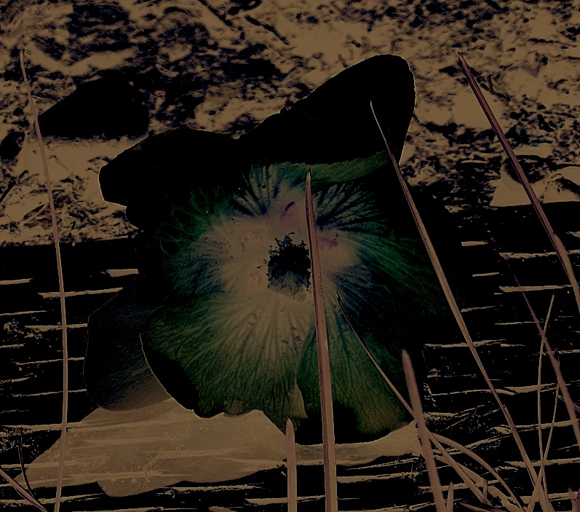
Challenging Problems
Image recognition in varied settings
Speech recognition in noise
Robotic control and navigation
Notes:
Type notes here

Slide 5
Artificial Neural Networks
Notes:
Type notes here

Slide 6
Biological Neuron
Notes:
Type notes here

Slide 7
Biological Neuron
Notes:
Type notes here

Slide 8
Perceptron
Notes:
Type notes here

Slide 9
Perceptron Response
Notes:
Type notes here

Slide 10
Linear Separability
Notes:
Type notes here

Slide 11
Linear Separability
Notes:
Type notes here

Slide 12
Logic Gates
Notes:
Type notes here

Slide 13
Parallel Processing
Notes:
Type notes here

Slide 14
Sigmoid Neuron
Notes:
Type notes here

Slide 15
Sigmoid Neuron Response
Notes:
Type notes here

Slide 16
Neural Network
Notes:
Type notes here

Slide 17
Neural Network
Notes:
Type notes here

Slide 18
Universal Approximation
Notes:
Type notes here

Slide 19
Universal Approximation
Notes:
Type notes here

Slide 20
Universal Approximation
Notes:
Type notes here

Slide 21
Function Approximations
Notes:
Type notes here

Slide 22
Learning
Notes:
Type notes here

Slide 23
Gradient Descent
Notes:
Type notes here

Slide 24
Local Minima
Notes:
Type notes here

Slide 25
Backward-Error Propagation
Notes:
Type notes here

Slide 26
Dynamic Networks
Notes:
Type notes here

Slide 27
Dynamic Networks
Notes:
Type notes here

Slide 28
Learning through Time
Notes:
Type notes here

Slide 29
Learning through Time
State
v₁
Adaptive Critic
0 or 1
noise
x₁
p
v₁₆
delay
λ
reward = ±1
decay
^
β
α
r
w₁
Associative Search
noise
y
θ
x₁₆
w₁₆
x
x
θ
θ
±F
Notes:
Type notes here

Slide 30
Pulsed Networks
Notes:
Type notes here

Slide 31
Pulsed Neuron
Notes:
Type notes here

Slide 32
Pattern Processing
Notes:
Type notes here

Slide 33
Response Regions
Notes:
Type notes here

Slide 34
Pattern Windows
Notes:
Type notes here

Slide 35
Pattern Windows
Notes:
Type notes here

Slide 36
Dynamic Pulsed Networks
Notes:
Type notes here

Slide 37
Applications
Notes:
Type notes here

Slide 38
Speech Recognition
Notes:
Type notes here

Slide 39
Auditory System
Notes:
Type notes here

Slide 40
Research Opportunities
Mathematically describe pattern processing
Devise pattern-learning algorithms
Build circuits
Notes:
Type notes here

Slide 41
Title
Notes:
Type notes here

